Slide 1
EES203: Geochemistry
Instructor: Anoop Ambili
Email id: anoop@iisermohali.ac.in

Slide 2
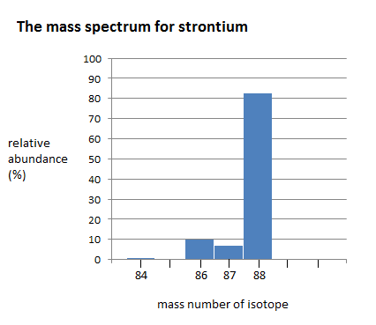
Isotopes of Strontium
The alkali earth metal strontium has four stable naturally occurring isotopes:
^{~84}Sr (0.56%)
^{~ 86}Sr (9.86%)
^{~87}Sr (7.0%) and
^{~88}Sr (82.58%)
Relative abundance (%)
Strontium isotopes
McArthur et al., 2012

Slide 3
Evolution of Strontium Isotope ratios
Fractionation of Rb/Sr between
upper mantle and continental crust
Evolution of ⁸⁷Sr / ⁸⁶Sr ratio from bulk earth ration since fractionation
Elderfield, 1985

Slide 4
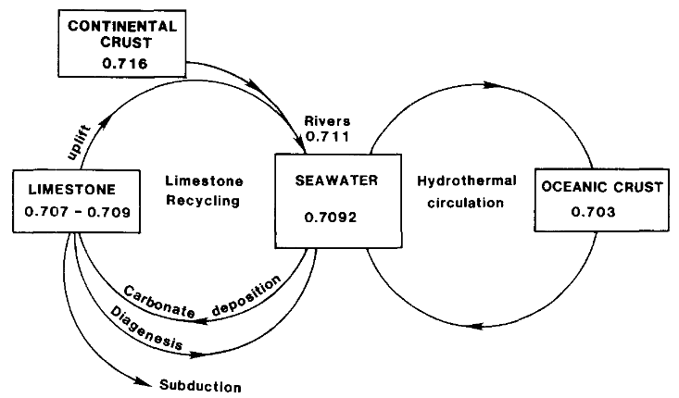
Geochemical cycle of strontium
Elderfield, 1985

Slide 5
Estimated values of Strontium Isotopes
Primordial ⁸⁷Sr/⁸⁶Sr ratio ~0.699
Strontium- depleted ocean basalts ~ 0.703
Strontium- enriched continental rocks ~0.701 to 0.740
Modern seawater has ⁸⁷Sr/⁸⁶Sr ~0.709

Slide 6
Applicability of Strontium for chemostratigraphy
Sr Ocean Residence Time (⁸⁷Sr): ~4 x 10⁶ yrs
Ocean Mixing Time: ~10³ yrs
Well-mixed with Sr at any point of time.
Negligible/near about absent effects of isotope fractionation
Absence of ⁸⁷Rb in carbonate phase

Slide 7
Strontium Isotope Stratigraphy
Strontium isotope stratigraphy relies on recognised variations in the ⁸⁷Sr/⁸⁶Sr ratio of seawater over time.
Using the more conventional biostratigraphic correlation techniques we can create high resolution stratigraphy of marine sedimentary sections.
⁸⁷Sr/⁸⁶Sr in a mineral precipitated from seawater, such as biogenic carbonate, micrite or a marine-derived evaporite, can be used to determine depositional age by comparison to a empirical calibrated curve of ⁸⁷Sr/⁸⁶Sr against time.

Slide 8
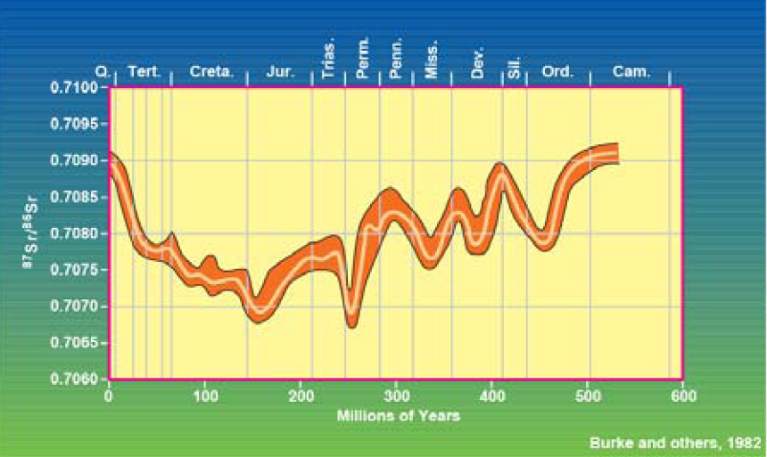
Change in Isotope ratio throughout Phanerozoic time
Veizer , 1989

Slide 9
Lowess curve and its use in Isotope Stratigraphy
LOWESS fit for the period 0-610 Ma with 95% confidence bounds. McArthur et al., 2001

Slide 10
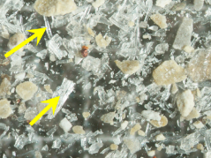
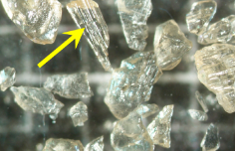
Ideal Materials for SIS
Samples must have high potential for retaining their original marine strontium isotope ratios.
High registance to Diagenesis.
Shells of Mg Calcitic composition yields narrow uncertainty bands.
Secondary Alteration are found and diagnosed beforehand to avoid mistaken results.
Foraminiferal, Belemnite Guards and Bivalve Shells etc.
Bivalve shell
Belemnite

Slide 11
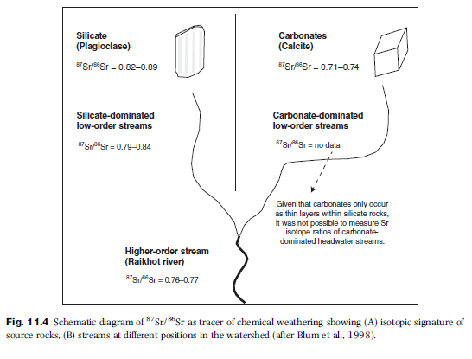
Applicability of Strontium for Weathering

Slide 12
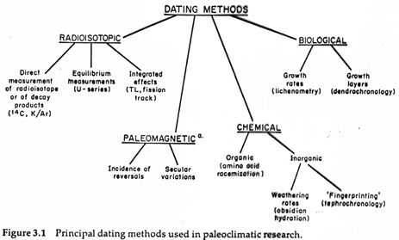

Slide 13
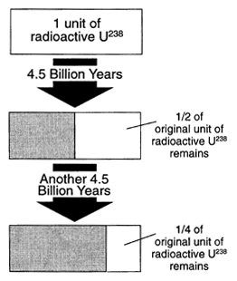
Principles of Radiometric Dating
C. How it works (radioactive decay)
1. Decay rates of radioactive atoms are constant
2. Unaffected by temperature, pressure, water, etc.
3. Half Life: time it takes for half the atoms of the parent isotope to decay, ranges from tens of billions of years to thousandths of a second.
Percentage of parent atoms that decay in each half life is the same (50%)
The actual number of atoms that decay with each passing half-life continually decreases
Increase in daughter = decrease in parent

Slide 14
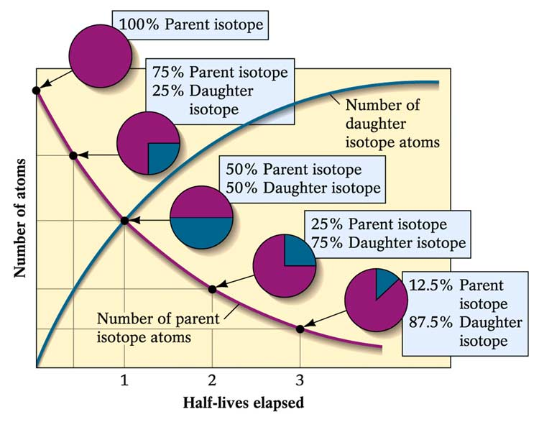
I. Principles of Numerical Dating
How it works (radioactive decay)
4. When mineral crystallizes (e.g., zircon mineral)
a. some amount of radioactive parent may get incorporated into the mineral structure
b. but daughter is different element and doesn’t “fit” in the structure (or inert and won’t combine), so at the time of formation there is 100% parent and 0% daughter

Slide 15
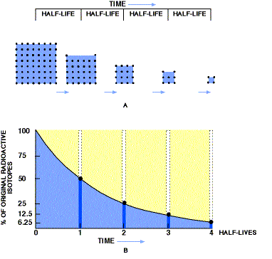
Principles of Numerical Dating

Slide 16
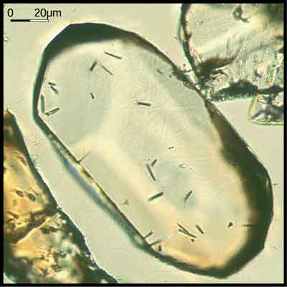
Principles of Numerical Dating
Radioactive isotopes are incorporated in minerals and rocks in a variety of ways.
As minerals crystallize from magma, radioactive isotopes are included in mineral crystal structure.
At the time of crystallization, only parent isotopes are included in the mineral.
Radioactive parent isotopes then begin to decay producing daughter isotopes.

Slide 17
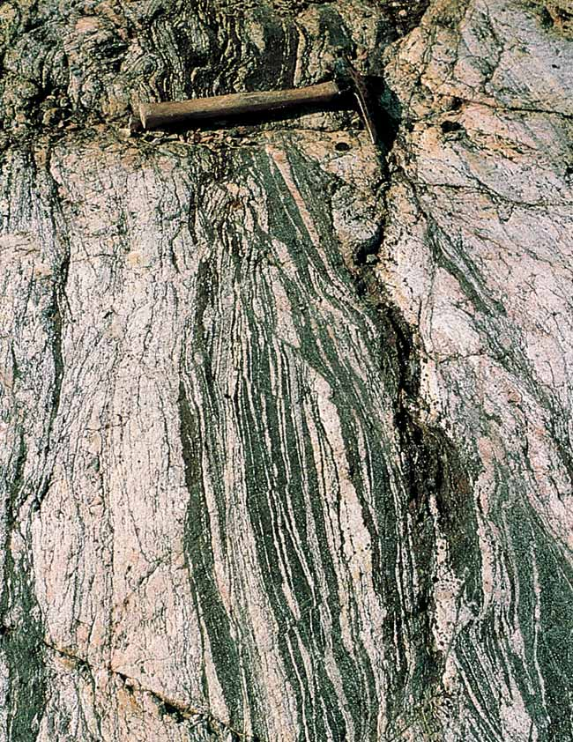
I. Principles of Numerical Dating
D. Dating Rocks
Igneous rocks – the best! Dates when the minerals formed
2. Metamorphic: during metamorphism ions can migrate, so dating tells us when metamorphism ended.
3. Sedimentary rocks: more errors because it dates the age of the individual pieces, gives maximum age

Slide 18
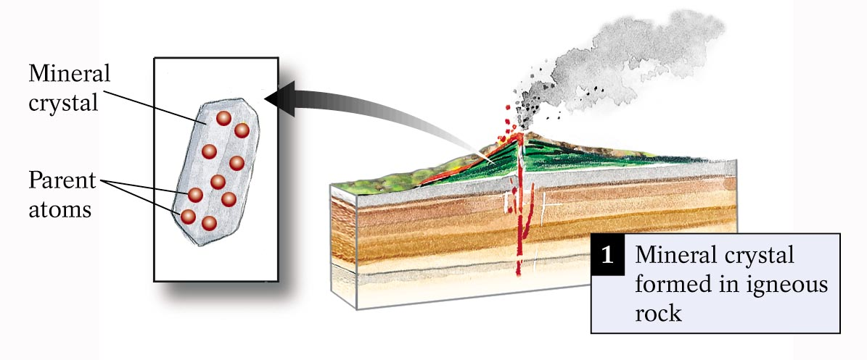
Principles of Numerical Dating

Slide 19
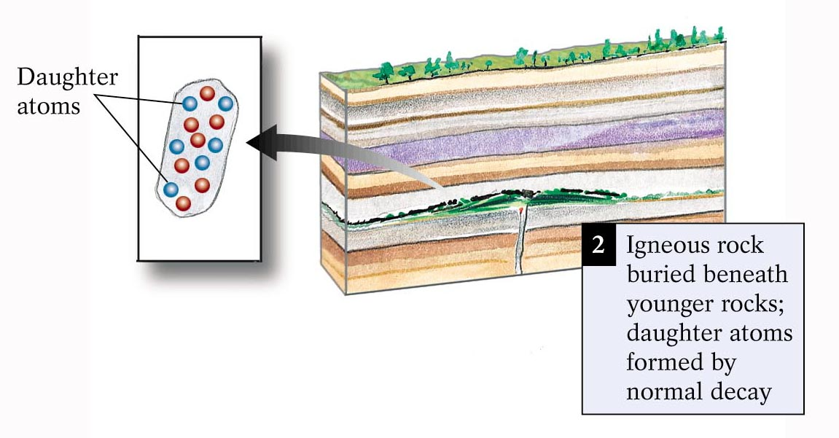
I. Principles of Numerical Dating

Slide 20
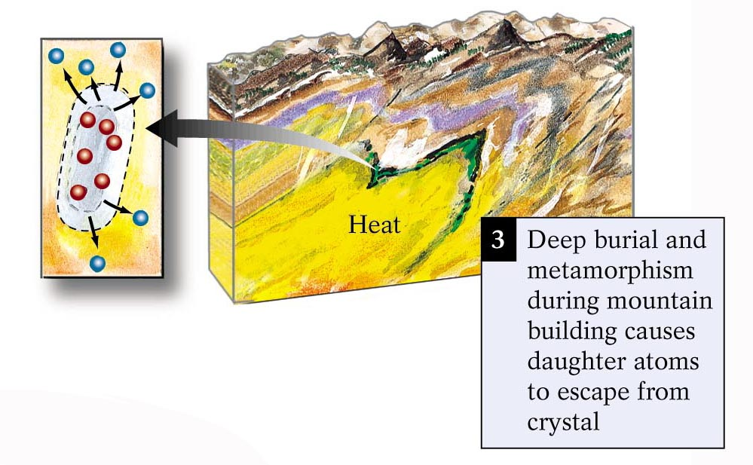
I. Principles of Numerical Dating

Slide 21
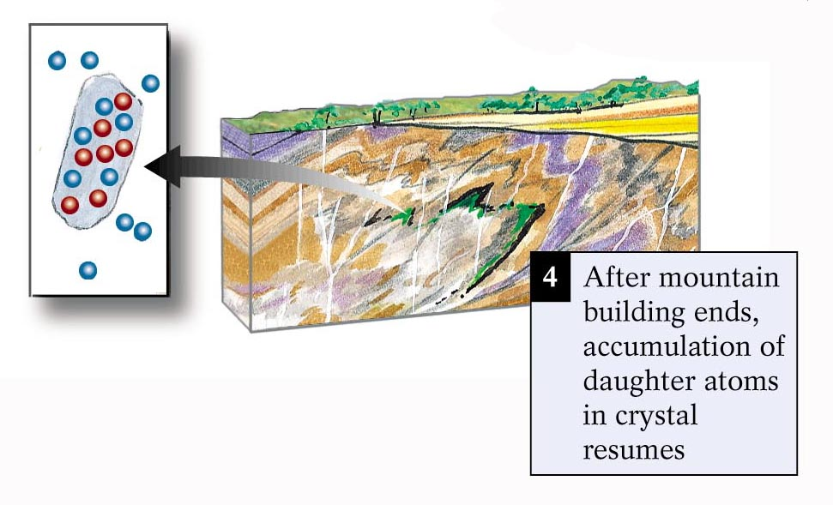

Slide 22
Principles of Numerical Dating
Sources of Error
Groundwater can bring in new ions and carry old ions away
Sample fractured and weathered rock, makes the age of the rock too young
Very young rocks: not enough time to accumulate daughter isotopes to be measured accurately
So we date many different samples and make sure the ages agree
We date using different dating methods to make sure they agree

Slide 23
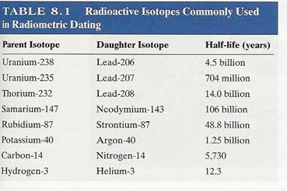
Types of Isotope Dating

Slide 24
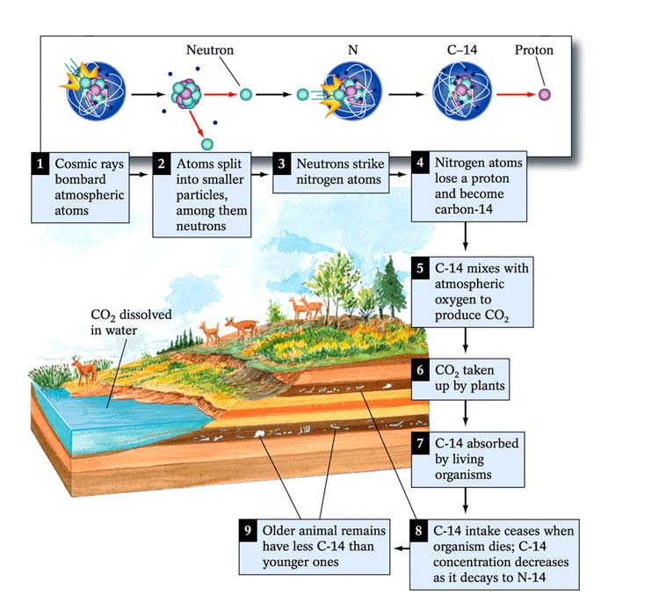
Radiocarbon dating
Naturally occurring isotope carbon-14 (¹⁴C) to determine the age of carbonaceous materials up to about 50,000 years
Raw (uncalibrated) radiocarbon ages are usually reported in radiocarbon years "Before Present" (BP)

Slide 25
Organic geochemistry

Slide 26
Important questions
How do organic-rich deposits form?
In which environmental settings is organic matter predominantly deposited?
What are the primary controlling factors influencing the deposition and preservation of organic matter in sedimentary environments?

Slide 27
General condition for OM formation
High primary productivity
Low energy depositional environment
Absence of dilution by inputs of inorganic mineral matter
Presevation rather than degradation by detritivores and decomposers

Slide 28
Controls on primary production
Photosynthesis
-Light
-Water: provides a ready source of the hydrogen needed for aerobic photosynthesis
- Temperature – solubility of CO₂ and inbit photosythesis by altering enzymes and cellular components
-Salinity: relatively few organisms can tolerate large fluctuations in salinity (e.g. where fresh water meets seawater in estuaries) and hypersaline conditions.

Slide 29
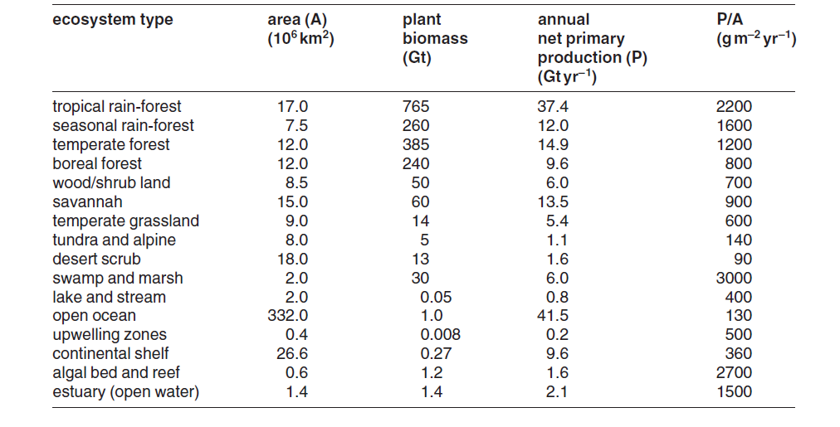
Primary productivity
Estimated primary productvity and biomass for various natural environments (sources: Whittaker and Likens 1975; DeVooys 1979)

Slide 30
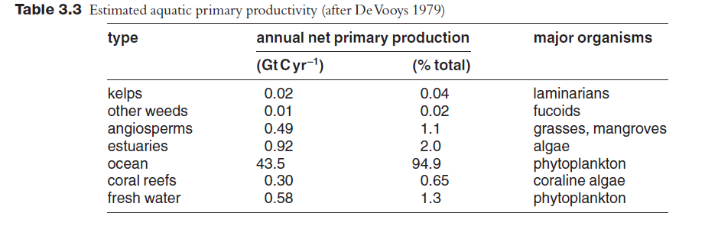
Aquatic productvity

Slide 31
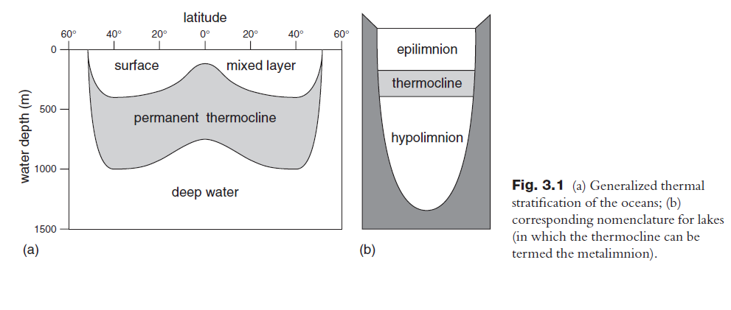
Controls on primary production
2. Stratification of the water column
Stratification in Ocean and Lake system

Slide 32
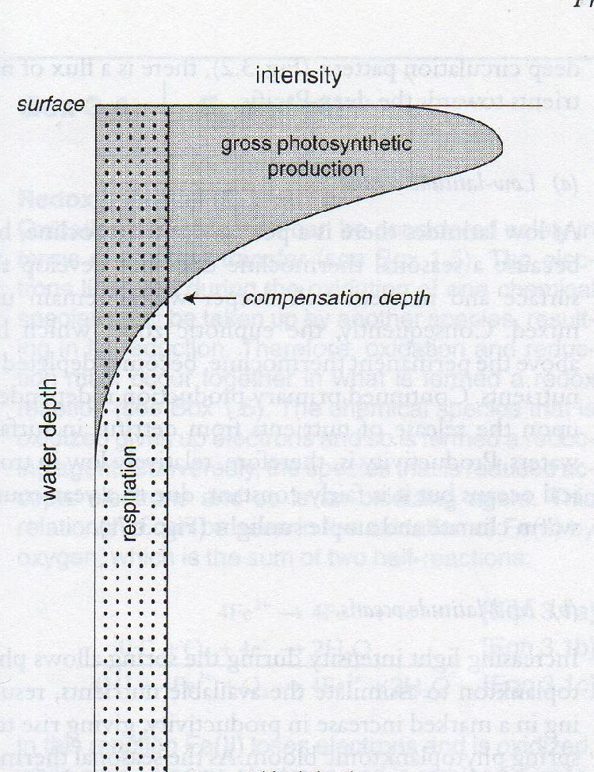
Controls on primary production
3. Light
euphotic zone
Relation between phytoplanktonic production, respiration and depth (ater Lalli and Parson, 1979)

Slide 33
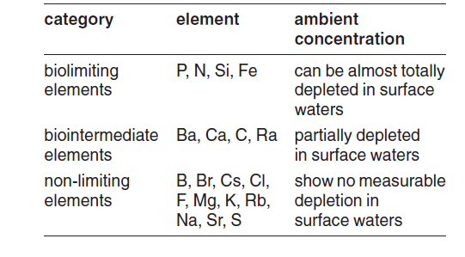
Controls on primary production
4. Nutrients
Classification and availability of essential elements in the ocean

Slide 34
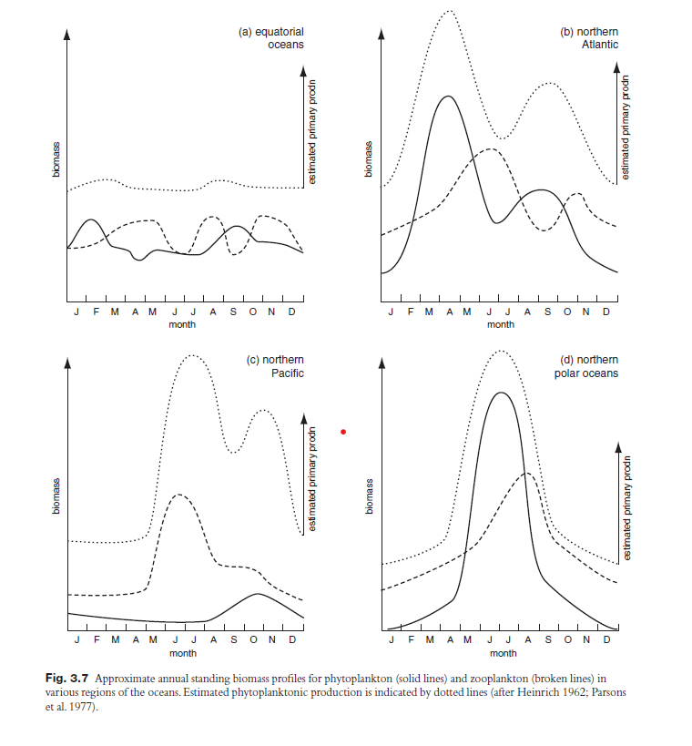

Slide 35
Controls on primary production
4. Nutrients
a) Low latitute ocean : Low productivity
b) Mid-latitude oceans: spring phytoplankton bloom
c) High latitude oceans: Light intensity available only during 5-6 months
single large algal bloom during the summer
d) Startified lakes: spring phytoplankton bloom

Slide 36
Spatial variation in marine primary production
The productvity is not uniform over the surface of oceans due to the effect of upwelling and downwelling on nutrient availabilty
The degree of flooding of continental margins is also important interms of the area of productive coastal waters
Nutrient supply from the land (e.g., rivers) contribute to th productvity of the shelf areas

Slide 37
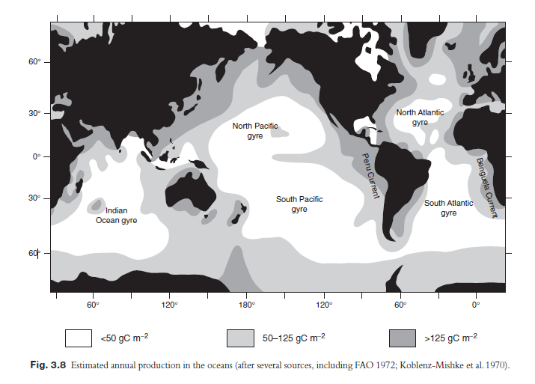
Spatial variation in marine primary production

Slide 38
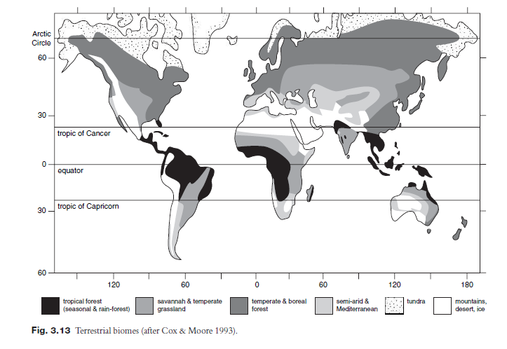
Spatial variation in terrestrial productivity

Slide 39
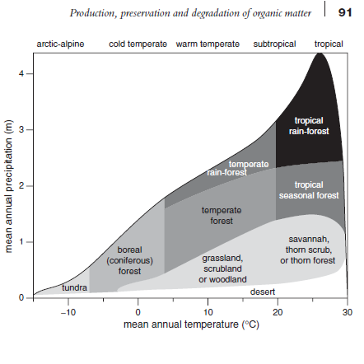
Variation in higher plant populations
Approximate correlation of terrestrial biomes with temperature and precipitation (after Whitaker 1975)

Slide 40
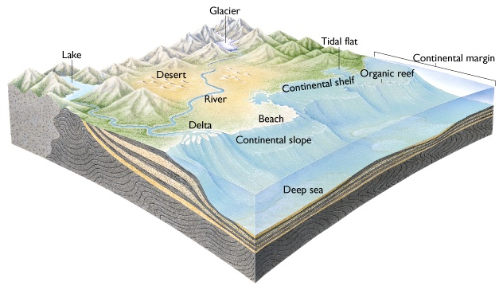
Depositional environment associated with accumulation of organic matter

Slide 41
Lacustrine environments
Closed and open lakes
- Autochthonous and allochthonous OM sources

Slide 42
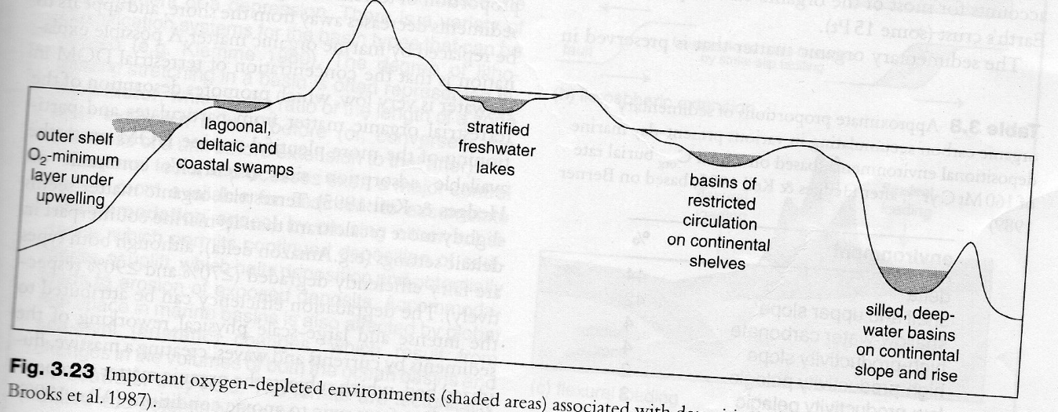
Depositional environment associated with accumulation of organic matter
Important oxygen depleted environmnt associated with deposition of organic rich sediments
(after Brooks et al. 1987)

Slide 43
Depositional environment associated with accumulation of organic matter
2. Coal forming mires
Accumulation of peat in mires requires
Gradual and continous rise in groundwater table
Protection of mire against flooding by rivers and seas
Low relief hinterland limiting supply of fluvial sediments

